Slide 1
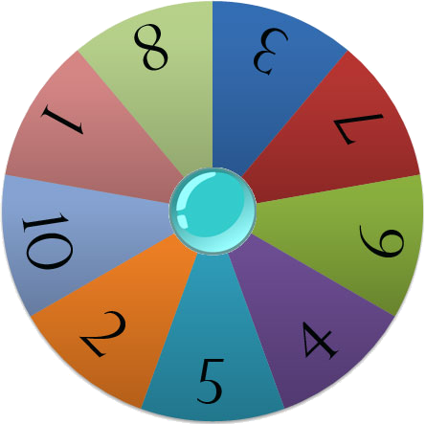
Which turn is it?
Choose:
More than 5 or
Less than 5
Spin Wheel
Points

